Slide 1
Lebensohl

Slide 2
Key Concepts
Responding to partner’s 1nt when opponents interfere
Doubles
Responding to partner’s 1nt when they interfere with 2c multi-landy

Slide 3
Partner opens 1nt…
You have the adjacent hand. Would you bid? Why would you bid?
What would you bid if partner opened 1nt and there was no interference?
What would you bid if partner opened 1nt and opponents bid 2♥ natural?

Slide 4
Partner opens 1nt…
You have the adjacent hand. Would you bid? Why would you bid?
What would you bid if partner opened 1nt and there was no interference?
What would you bid if partner opened 1nt and opponents bid 2♥ natural?

Slide 5
What can you do to show the difference between these two hands if the bidding has gone: 1NT – (2h) -? How do you show the difference between a good hand and a hand that just wants to compete

Slide 6
Partner opens 1nt…
You plan to stayman but East gets in your way and bids 2 diamonds.
You don’t have diamond stoppers so you cant gamble 3nt.
If you cue bid 3d you might miss your heart fit and what do you do if partner bids 3 spades?
You still don’t know about the diamond stoppers? What about double? If you double and partner bids 2 spades then what do you do? And is double for penalties?

Slide 7
If opposition interferes over our NT, we need a way to differentiate between bids that are:
Forcing
Non-forcing
Invitational
Bids that ask partner about 4 card Major suits
Bids that show stoppers
Bids that deny stoppers
For all of this we use Lebensohl

Slide 8
After an opponent overcalls our partner’s 1nt we use 2nt to force partner to bid 3c so we can both clarify our hands

Slide 9
When we have the good hand…
We are bold and direct and don’t mess around. We bid our 5 card suit directly at the 3 level

Slide 10
When we have the weak (just competitive hand)
We mutter and stutter and bid 2nt first.
2nt forces partner to bid 3c and we pass or correct in the minor

Slide 11
When we have the weak (just competitive hand)
We mutter and stutter and bid 2nt first.
2nt forces partner to bid 3c and we pass or correct in the minor

Slide 12
Mini-quiz: Partner opens 1nt, opponent overcalls 2♠. What do you do with the following hands?
A B. C. D.

Slide 13
All the previous examples illustrated what you should do if you were forced to show your suit at the 3 level but what about when you can bid your suit at the 2 level

Slide 14
Non- forcing hands bid at the 2 level

Slide 15
Forcing hands: jump to the three level

Slide 16
Invitational hands: go via 2nt then when partner bids 3c correct to 3s

Slide 17
Mini-quiz: Partner opens 1nt, opponent overcalls 2♦. What do you do with the following hands?
A B. C. D.

Slide 18
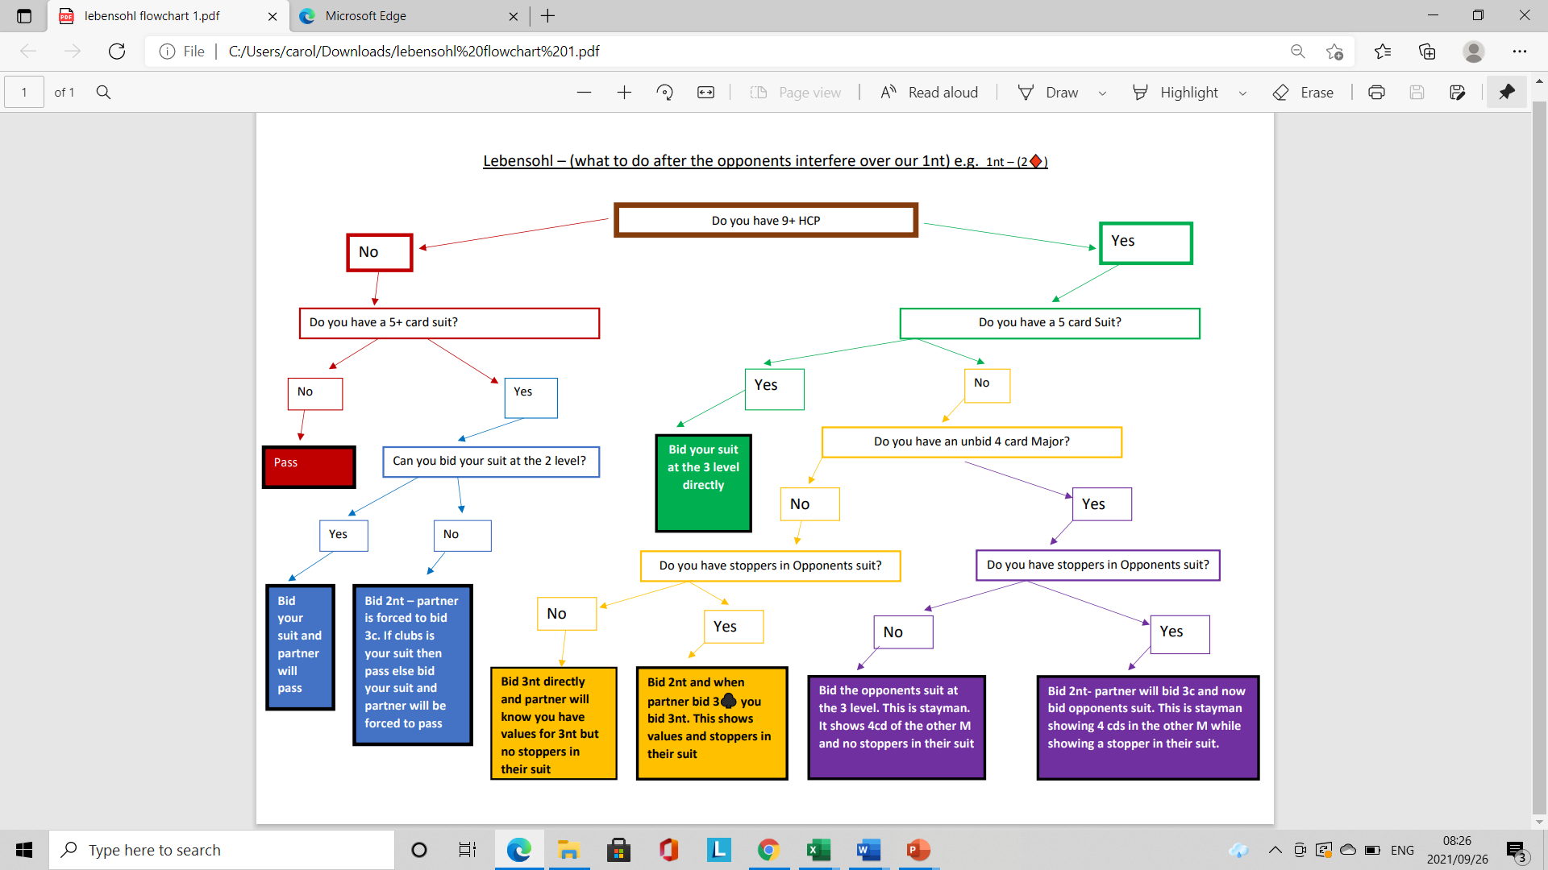

Slide 19
What do you do if you don’t have a 5-card suit, but have 4 cards in the other Major? Bidding their suit shows 4 cards of the other Major but…

Slide 20
What do you suppose the difference is between these two auctions? One goes via lebensohl and one bids 3 of the opponent’s suit directly…

Slide 21
FADS Fast Arrival Denies Stoppers

Slide 22
FADS Fast Arrival Denies Stoppers

Slide 23
FADS Fast Arrival Denies Stoppers

Slide 24
North opens 1NT, how should the bidding progress?

Slide 28
Mini-quiz: Partner open’s 1nt, opponent overcalls 2♥, what should you do with the following hands?
A B. C. D.

Slide 29
What do you do if you have a balanced hand, no 4-card major and are looking to play in 3nt? What do you suppose the difference is between these two auctions?

Slide 30
FADS Fast Arrival Denies Stoppers

Slide 31
Mini-quiz: Partner opens 1nt, opponents bid 2♥ (natural), what do you do with the following hands?
A B. C. D.

Slide 33
Doubles Doubles of any overcall used to be for penalties. Most players now use double as take-out. The easiest way to play it is that it is take out of any suit (whether natural or conventional) the opponents bid. So 1nt-(2c) – dbl is take out of clubs whether clubs is natural or artificial.

Slide 34
Doubles Alternative treatment when they overcall 2c and it shows both Majors is: dbl = values no clear direction and all subsequent doubles are for penalty Lebensohl applies: 2d/2h/2s: weak and to play 2nt: forces 3c (to play) 3d/3h/3s: good hand forcing 3nt: values without stoppers in both Major
Double and if the opponents bid spades you can double for penalties
Bid 2d showing a non-forcing bid with long diamonds

Slide 35
Doubles vs Stayman Double will generally show a more unbalanced hand with - Shortage in opponent’s suit - Side has majority of the values -Support in the other three suits (can have only 3 cards in the other Major) Stayman is slightly more balanced with more cards in their suit

Slide 37
Using Lebensohl against pre-emptive weak 2s When partner doubles a weak 2, we can use lebensohl to distinguish between a hand that is being made to bid and a good hand.

Slide 38
Using Lebensohl against pre-emptive weak 2s When weak: bid 2nt which forces partner to bid 3c, then pass or correct to the longest suit you wish to play in. Partner will pass and you can stay out of trouble.

Slide 39
Using Lebensohl against pre-emptive weak 2s When partner doubles a weak 2, and you have a good hand bid your suit directly at the 3 level: (2s)- dbl- (p) -3c

Slide 40
Using Lebensohl against pre-emptive weak 2s If your suit is available at the 2 level then you can show the difference between a weak hand, a good hand with a 4-card suit, a good hand with a 5-card suit

Slide 42
Thank you for attending, I hope you will be able to use Lebensohl and a big thank you to Personal Trust for sponsoring this lecture

Slide 43
Alternative way to deal with opponent's artificial bids that show both majors (2c): 2d: to play 2nt is still lebensohl to have partner transfer into clubs to pass or if you bid one of the majors it shows game going values with stoppers in that Major asking for stoppers in the other Major 3d: forcing showing d 2h: both minors (better clubs) p to choose best minor 2s: both minors (better diamonds) p to choose best minor 3h: Heart shortage both minors 3s: spade shortage both minors 3nt: values but not necessarily have stoppers in the majors dbl: balanced hand with values and no real direction but the hand belongs to us – afterwards all other doubles are for penalties
You showed both minors, partner chooses clubs, if you had a weak hand you could pass but with some stoppers in hearts and game going values you bid 3h, if partner has spade stoppers they bid them.

